Slide 1

Final Project
New Life App
NEXT

Slide 2
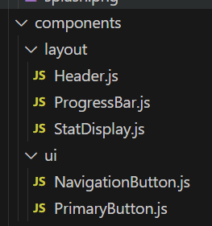
Component
From:
Layout manages how elements are arranged and organized on the interface
UI contains elements that are specific components of the interface with which the user will interact and manipulate
To:
NEXT

Slide 3
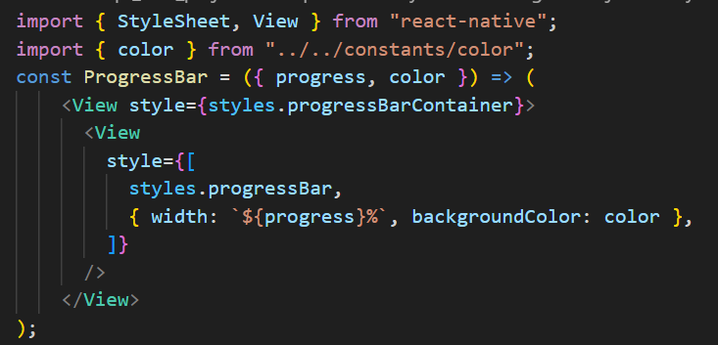
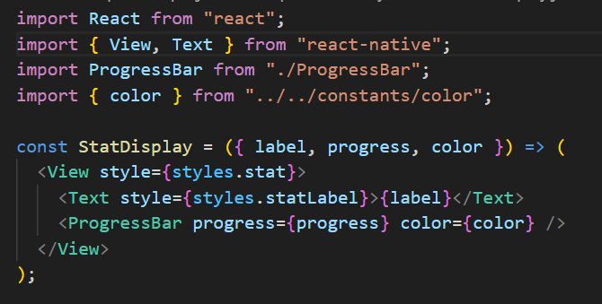

Layout Component
This line dynamically sets the width and background color of the progress bar based on the progress and color props, respectively, allowing for a flexible and customizable appearance of the progress bar component.
StatDisplay import ProgressBar
<Text> component: Displays the label prop passed to the StatDisplay component.
<ProgressBar> component: This component renders a progress bar with the progress and color props passed down to it. The progress and color props are forwarded to the ProgressBar component from the StatDisplay component.
NEXT

Slide 4
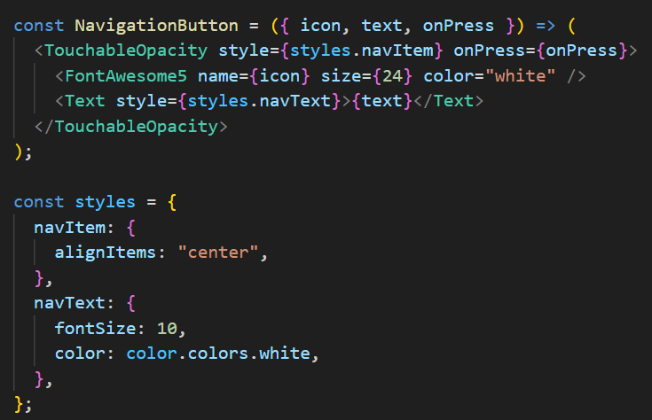
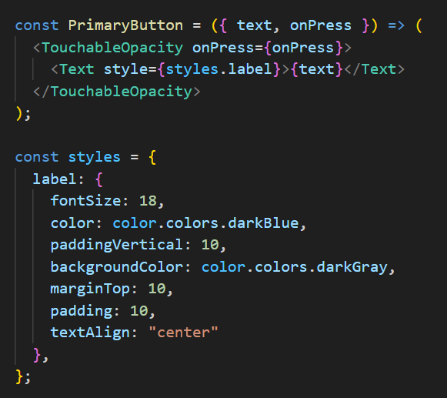
UI Component
<TouchableOpacity> : container for the button. This component provides touchable feedback when pressed.
<FontAwesome5> : Renders the icon specified by the icon prop using the FontAwesome5 font icon library. The name, size, and color props are set to customize the appearance of the icon.
<Text>: Displays the text label specified by the text prop.
text: Represents the text label to be displayed on the button.
onPress: Represents the function to be called when the button is pressed. It's assumed to be a callback function handling the button press event.
NEXT

Slide 5
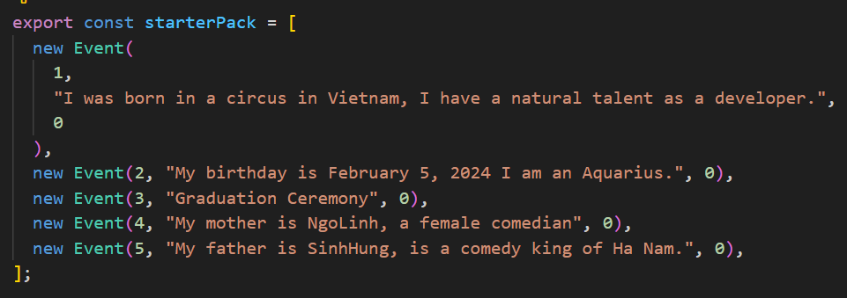
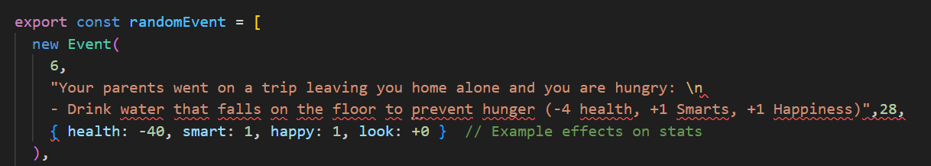
Data
Original data when user start game
When click + age, data randomEvent appear
NEXT

Slide 6
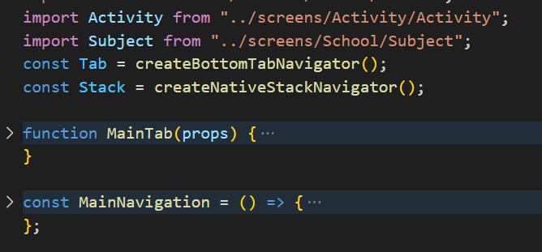
Main Navigation
2. Import
1. Overview
import from screens to main navigation in order to navigate screen when click sreen option
Overall form is structurized of a function Main Tab and a Main Navigation
3. Function MainTab
Main tab appear in main screen bottom footer
4. MainNavigation
all required custom fonts are loaded before rendering the main navigation structure of the application

Slide 7
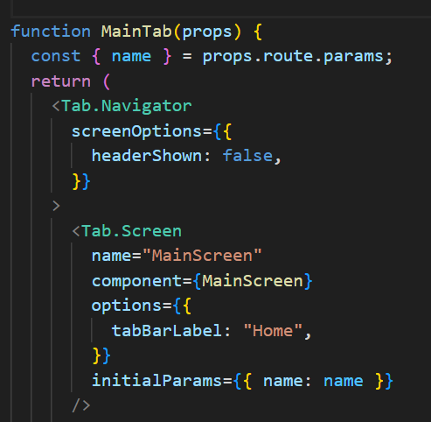
Main Navigation
Function MainTab
The screenOptions prop is passed to the Tab.Navigator, configuring options for all screens within the navigator.
headerShown is set to false, which means the header will not be shown for any screen within the tab navigator.
tabBarLabel option is set to "Home" for this tab, which likely specifies the label displayed in the tab bar for this screen.
The initialParams prop is used to set the initial parameters for the screen, sets the name parameter to the value received from the navigation route.
NEXT

Slide 8
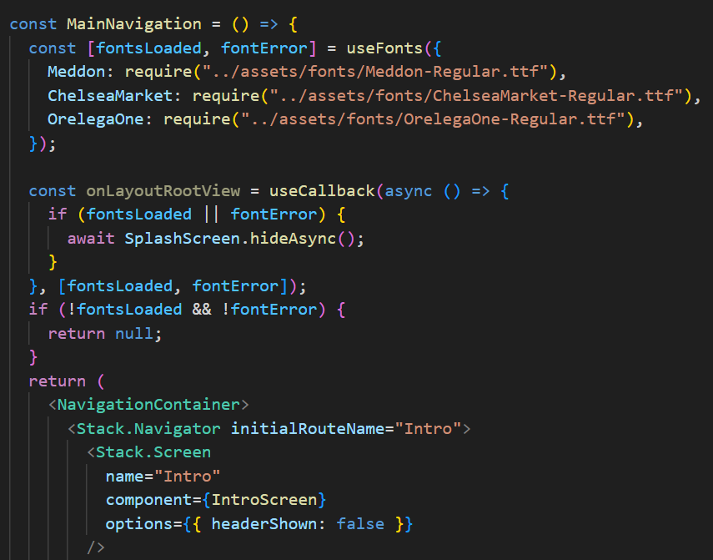
Main Navigation
The useFonts hook is used to load custom fonts required for the application. It loads the fonts specified in the object passed to it.
The fontsLoaded variable stores a boolean indicating whether the fonts have been successfully loaded.
The fontError variable stores any potential error that may occur during font loading.
The Stack.Screen component defines a screen named "Intro" and associates it with the IntroScreen component. The options prop hides the header for this screen.
NEXT

Slide 9
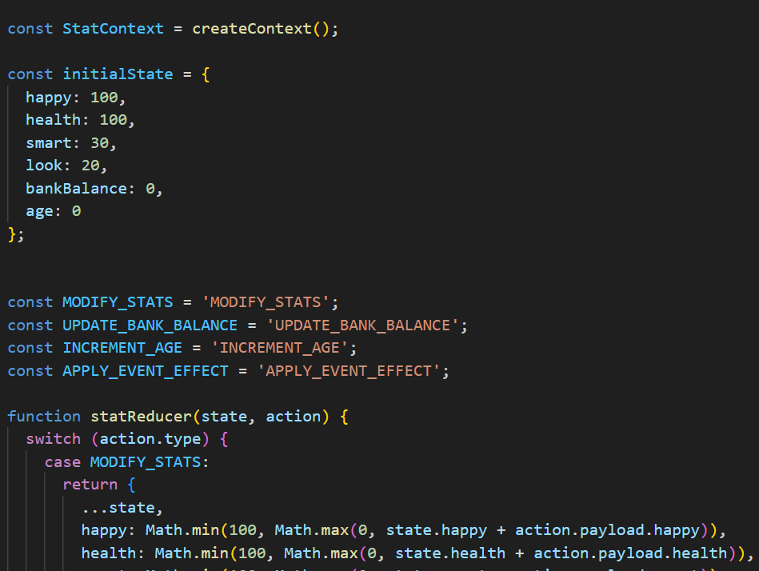
StatContext
Define the context
Initial state for the stats
Action types for context updates
Reducer to handle actions
NEXT

Slide 10
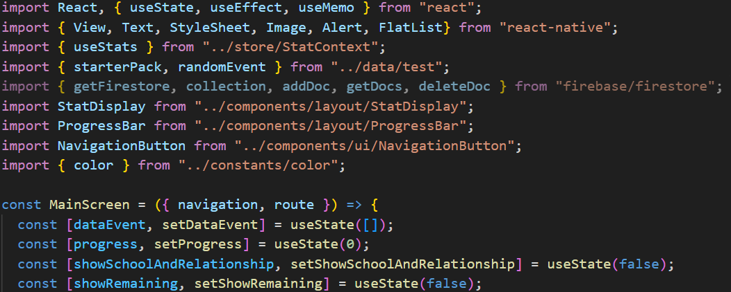
MainScreen
Import: Required modules and components from the React library, React Native, and custom components from your project.
Component declaration: Declare the MainScreen component with navigation and routing props to navigate and pass data between screens.
dataEvent: Array to store events by age.
progress: Variable that manages the time status bar progress.
showSchoolAndRelationship: Manages the display of navigation buttons for School and Relationship.
showRemaining: Manages the display of remaining navigation buttons when a certain age is reached.
NEXT

Slide 11
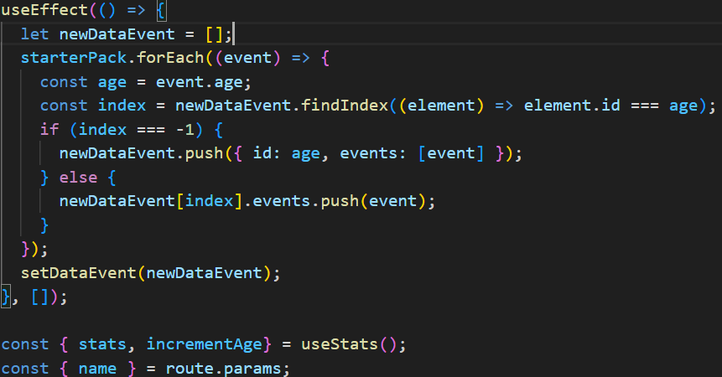
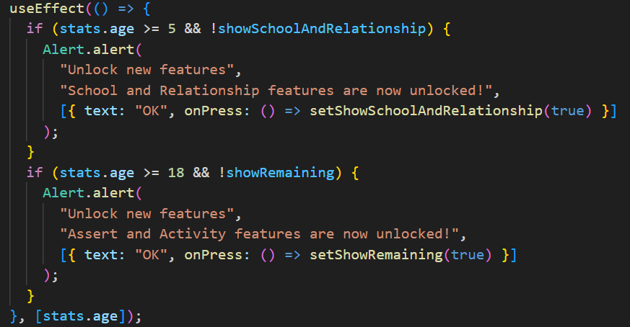
MainScreen
Effect Hook: Used to initialize data from starterPack, group events by age.
Check age to display notifications to unlock new features like School, Relationships, Affirmations, and Activities.
NEXT

Slide 12
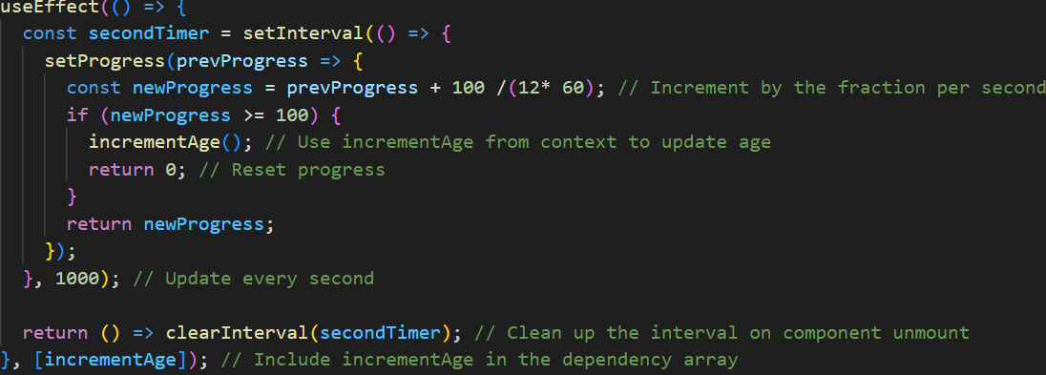
MainScreen

Slide 13

Thank You For Your Attention!

